Slide 1
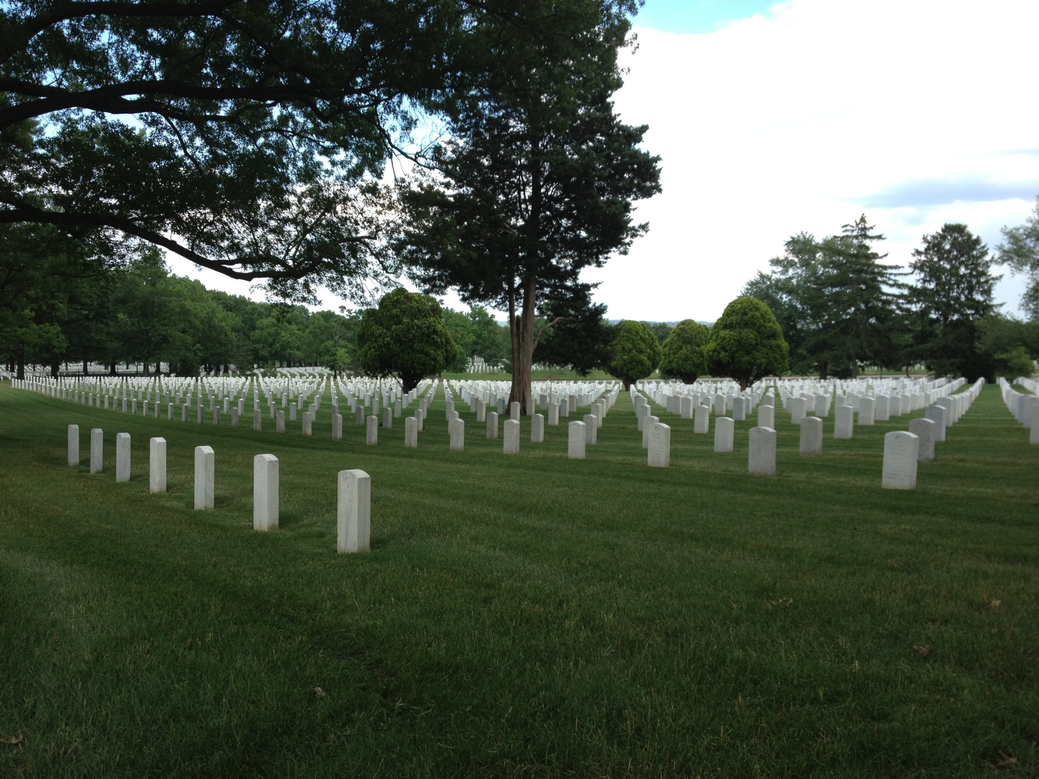
Arlington National Cemetery
The Legal, Ethical, Moral Questions Behind the Union Confiscation Measures of the Civil War

Slide 2
The Simple Facts
Who?
  Union
    General Winfeild Scott (Commander in Chief of Union Forces)
    General J. F. K. Mansfeild (Commander of the Department of Washington)
    Union forces
  Lee Family
    Robert E. Lee
    Mary Ann Randolph Custis Lee (Mrs. Robert E. Lee, only daughter of George Washington Parke Custis)
    George Washington Parke Custis (Father of Mrs. Lee, Grandson of Martha Washington and adopted son on George Washington)
What?
  Union forces take possession of Arlington Heights on May 24th 1861 and fortify the property and surrounding area
Why?
  Ideal location for fortification - Allowing Confederate army to retain control of the land overlooking the capital of Washington would have been incredibly detrimental to Union forces and may even have resulted in the subsequent relocation of the seat of the Union government.

Slide 3
The Issues
Legal
  Confiscation Acts barely passed in the United States Congress
    Even Lincoln considered them to be Unconstitutional
    Not well defined and only enforceable in the north
  An Act for the Collection of Direct Taxes in the Insurrectionary Districts within the United States
    Allowed tax collectors to refuse payment from anyone other than home owner → taking advantage of war widows and their families
Ethical/Moral
  Property legally owned by the Lee Family
  Extreme sentiment attached to the property
    Built by Mary Lee’s father in honor of her great great grandfather, Georgw Washington
    Robert E. Lee Married Mary Custis there
    Together they raised 7 children under the roof of the Arlington House
  A rich family member provided the money to pay the taxes on the estate, but the Union Government would not accept the funds
  Robert E. Lee and Mrs. Lee not given the right to be buried at their ancestral home along side Mary’s’ Family

Slide 4
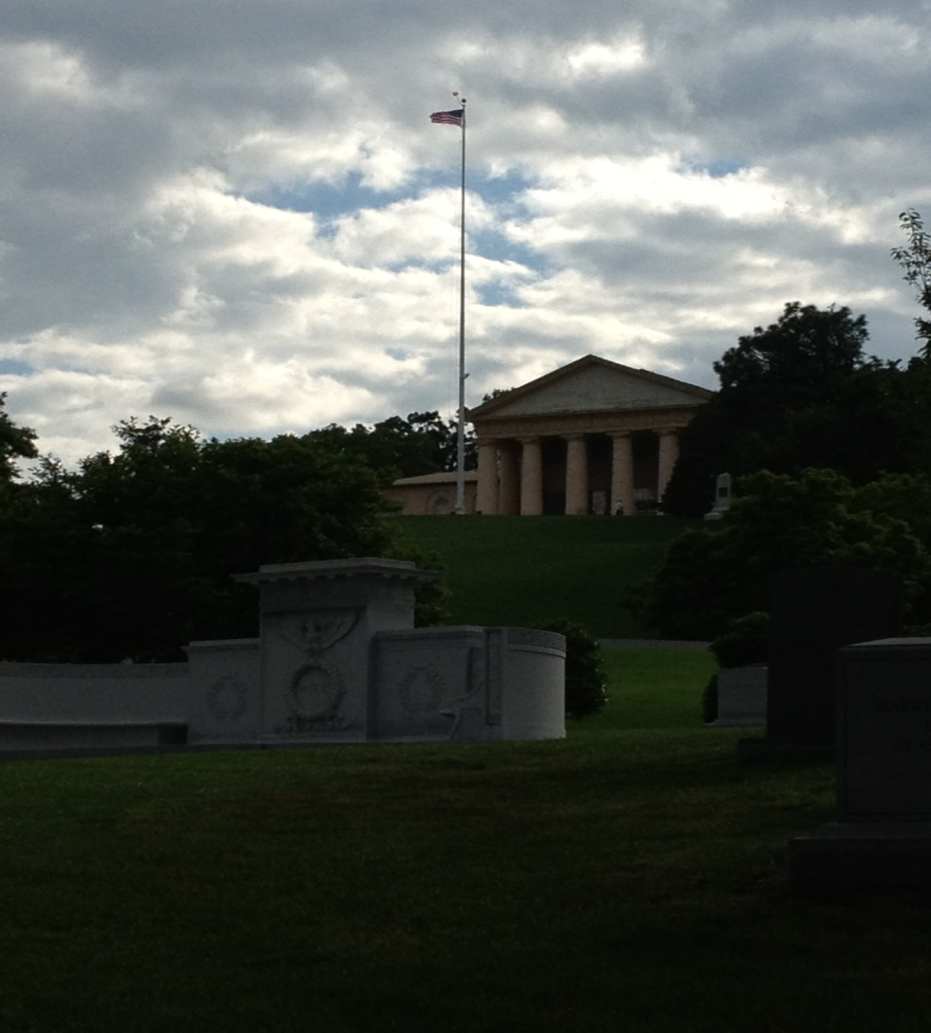
Historical Argument
The Union government seized the 1,100 acres of the Arlington Heights on May 24th 1861 with the intention of retaining that property and real estate, thereby violating not only the Lee family’s right to due process of the law but also the retainer clause of the United States Constitution.

